Slide 1

Homework Boolean Functions
Iliesi Antonia Catrinel
Group 913

Slide 2
Problem Statement
Exercise 8
Using Moisil’s method simplify the following Boolean function of 3 variables:
3. f3(x1,x2,x3)= m1 ˅ m2 ˅ m3 ˅ m5 ˅ m6

Slide 3
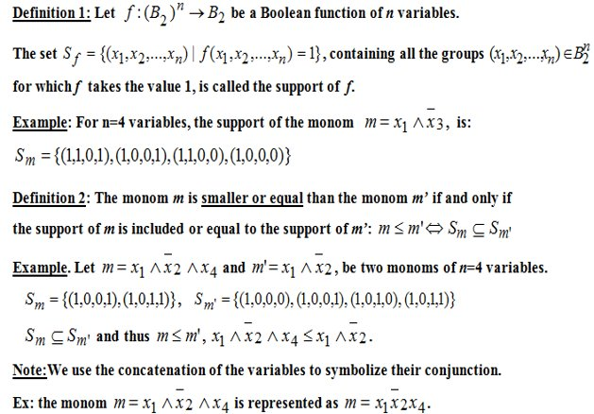
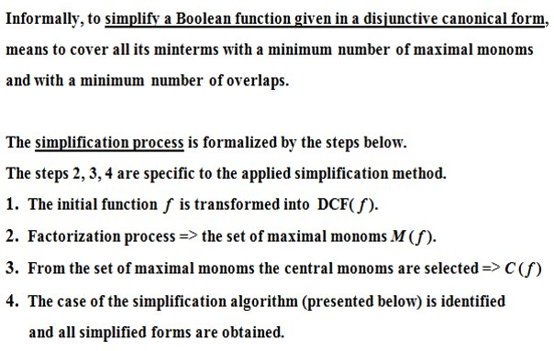
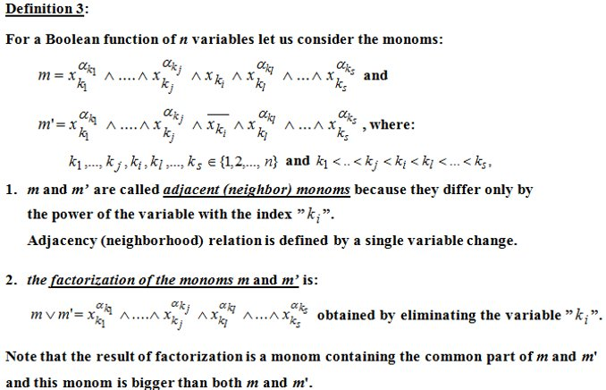
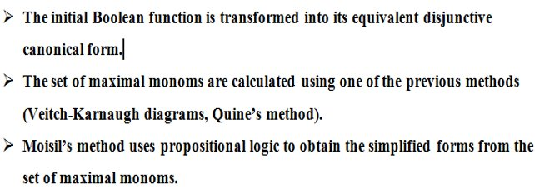
Theoretical Results
Moisil’s simplification method steps:

Slide 4
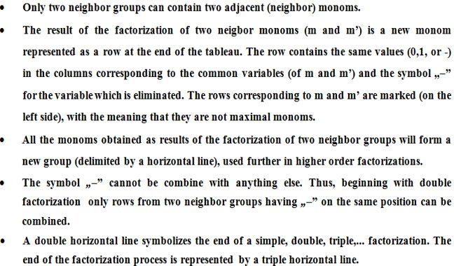
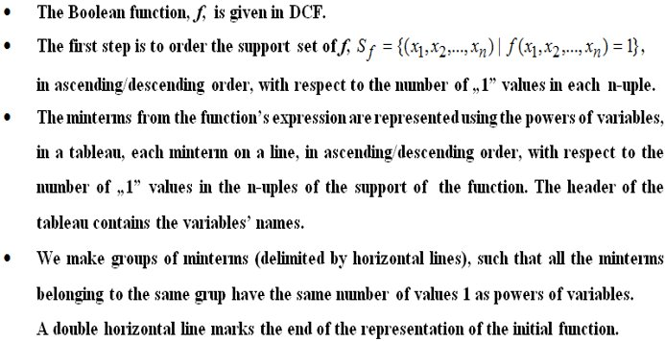
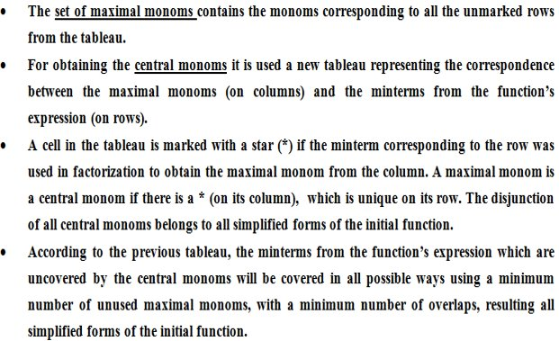
Theoretical results
Quine’s simplification method to obtain maximal monoms:

Slide 5
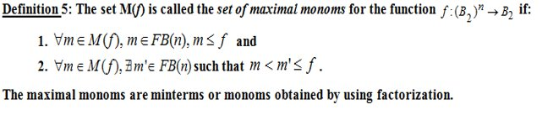
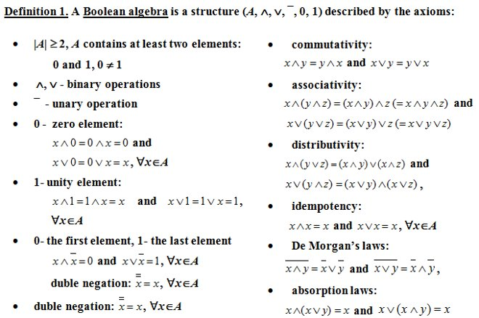
Theoretical Results
Axioms used:

Slide 6
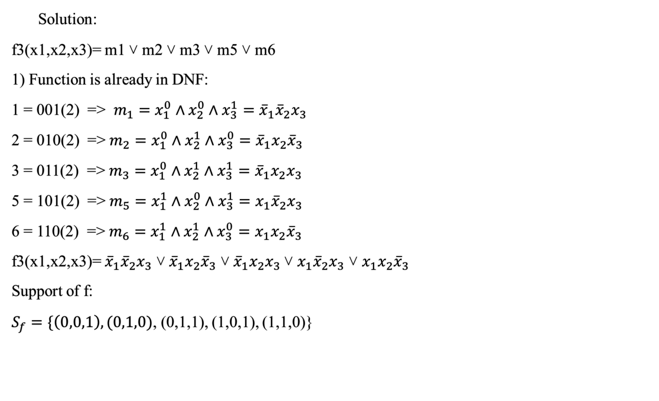
Solution:
f3(x1,x2,x3)= m1 ˅ m2 ˅ m3 ˅ m5 ˅ m6
1) Function is already in DNF:
1 = 001(2) => $m_{1}=x_{1}^{0}∧x_{2}^{0}∧x_{3}^{1}={\overline{x}}_{1}{\overline{x}}_{2}x_{3}$
2 = 010(2) => $m_{2}=x_{1}^{0}∧x_{2}^{1}∧x_{3}^{0}={\overline{x}}_{1}x_{2}{\overline{x}}_{3}$
3 = 011(2) => $m_{3}=x_{1}^{0}∧x_{2}^{1}∧x_{3}^{1}={{\overline{x}}_{1}x}_{2}x_{3}$
5 = 101(2) => $m_{5}=x_{1}^{1}∧x_{2}^{0}∧x_{3}^{1}=x_{1}{\overline{x}}_{2}x_{3}$
6 = 110(2) => $m_{6}=x_{1}^{1}∧x_{2}^{1}∧x_{3}^{0}=x_{1}x_{2}{\overline{x}}_{3}$
f3(x1,x2,x3)= ${\overline{x}}_{1}{\overline{x}}_{2}x_{3}$ ˅ ${\overline{x}}_{1}x_{2}{\overline{x}}_{3}$ ˅ ${{\overline{x}}_{1}x}_{2}x_{3}$˅ $x_{1}{\overline{x}}_{2}x_{3}$ ˅ $x_{1}x_{2}{\overline{x}}_{3}$
Support of f:
$S_{f}=\{\left(0,0,1\right), (0,1,0)$, (0,1,1), (1,0,1), (1,1,0)}

Slide 7
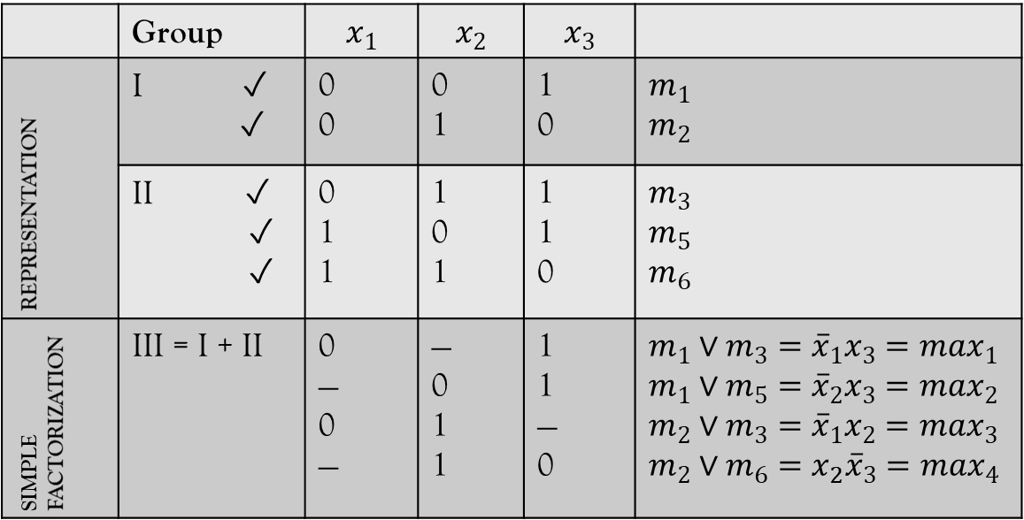


f3(x1,x2,x3)= m1 ˅ m2 ˅ m3 ˅ m5 ˅ m6 = ${\overline{x}}_{1}{\overline{x}}_{2}x_{3}$ ˅ ${\overline{x}}_{1}x_{2}{\overline{x}}_{3}$ ˅ ${{\overline{x}}_{1}x}_{2}x_{3}$˅ $x_{1}{\overline{x}}_{2}x_{3}$ ˅ $x_{1}x_{2}{\overline{x}}_{3}$
2) The set of maximal monoms is obtained using Quine’s method:
$S_{f}=\{\left(0,0,1\right), (0,1,0)$, (0,1,1), (1,0,1), (1,1,0)} – support of f in ascending order, with respect to the number of 1 values in each tuple
Factorization process:
 | Group | $$x_{1}$$ | $$x_{2}$$ | $$x_{3}$$
REPRESENTATION | I ✓ ✓ | 0 0 | 0 1 | 1 0 | $$m_{1}$$ $$m_{2}$$
 | II ✓ ✓ ✓ | 0 1 1 | 1 0 1 | 1 1 0 | $$m_{3}$$ $$m_{5}$$ $$m_{6}$$
SIMPLE FACTORIZATION | III = I + II | 0 — 0 — | — 0 1 1 | 1 1 — 0 | $$m_{1}∨m_{3}={\overline{x}}_{1}x_{3}=max_{1}$$ $$m_{1}∨m_{5}={\overline{x}}_{2}x_{3}=max_{2}$$ $$m_{2}∨m_{3}={\overline{x}}_{1}x_{2}=max_{3}$$ $$m_{2}∨m_{6}=x_{2}{\overline{x}}_{3}=max_{4}$$
Maximal monoms are unmarked rows from
the tableau:
$max_{1}$ $={\overline{x}}_{1}x_{3}$ $=$ $m_{1}∨m_{3}$
$max_{2}$ $={\overline{x}}_{2}x_{3}$ $=$ $m_{1}∨m_{5}$
$max_{3}$ $={\overline{x}}_{1}x_{2}$ $=$ $m_{2}∨m_{3}$
$max_{4}$ $=x_{2}{\overline{x}}_{3}$ $=$ $m_{2}∨m_{6}$
M(f) = {$max_{1},max_{2}$, $max_{3}$, $max_{4}\}$ = {${\overline{x}}_{1}x_{3}, {\overline{x}}_{2}x_{3},$ ${\overline{x}}_{1}x_{2}, { x}_{2}{\overline{x}}_{3}$}
We do not have double factorizations.

Slide 8
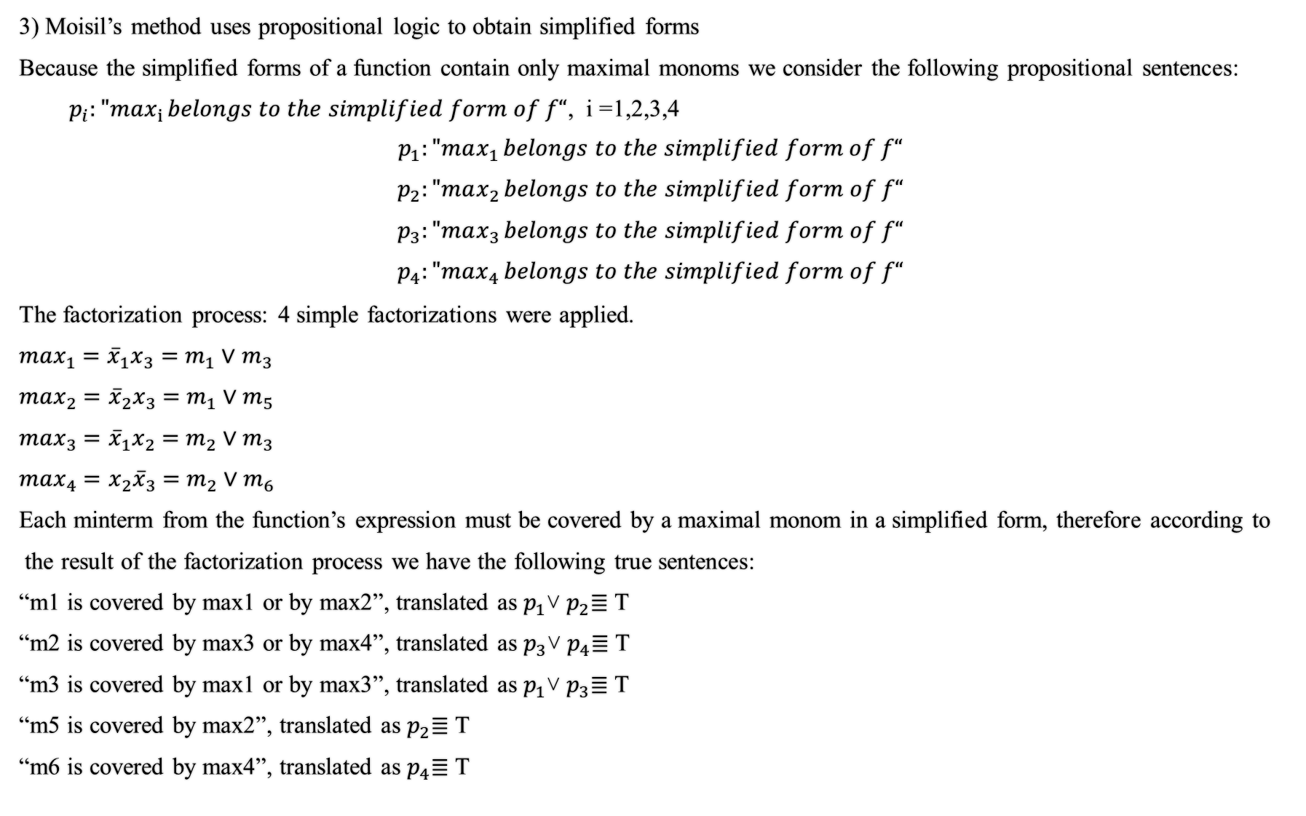
3) Moisil’s method uses propositional logic to obtain simplified forms
Because the simplified forms of a function contain only maximal monoms we consider the following propositional sentences:
$p_{i}:"max_{i }belongs to the simplified form of f“$, i =1,2,3,4
$$p_{1}:"max_{1 }belongs to the simplified form of f“$$
$$p_{2}:"max_{2 }belongs to the simplified form of f“$$
$$p_{3}:"max_{3 }belongs to the simplified form of f“$$
$$p_{4}:"max_{4 }belongs to the simplified form of f“$$
The factorization process: 4 simple factorizations were applied.
$max_{1}$ $={\overline{x}}_{1}x_{3}$ $=$ $m_{1}∨m_{3}$
$max_{2}$ $={\overline{x}}_{2}x_{3}$ $=$ $m_{1}∨m_{5}$
$max_{3}$ $={\overline{x}}_{1}x_{2}$ $=$ $m_{2}∨m_{3}$
$max_{4}$ $=x_{2}{\overline{x}}_{3}$ $=$ $m_{2}∨m_{6}$
Each minterm from the function’s expression must be covered by a maximal monom in a simplified form, therefore according to
the result of the factorization process we have the following true sentences:
“m1 is covered by max1 or by max2”, translated as $p_{1}$˅ $p_{2}$≣ T
“m2 is covered by max3 or by max4”, translated as $p_{3}$˅ $p_{4}$≣ T
“m3 is covered by max1 or by max3”, translated as $p_{1}$˅ $p_{3}$≣ T
“m5 is covered by max2”, translated as $p_{2}$≣ T
“m6 is covered by max4”, translated as $p_{4}$≣ T

Slide 9
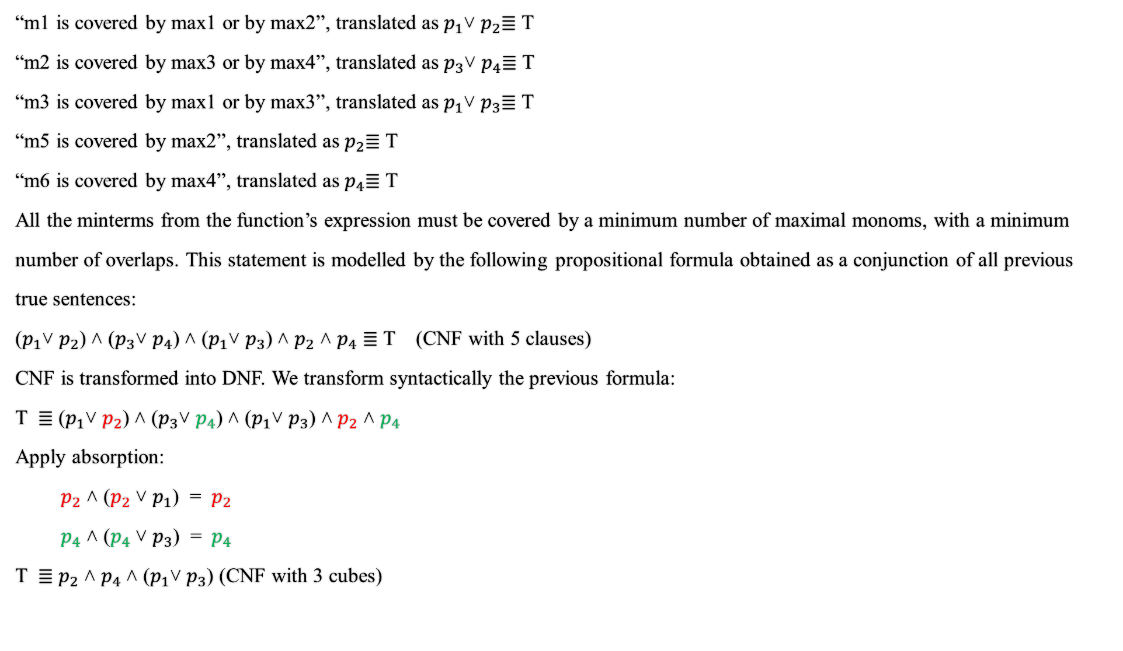
“m1 is covered by max1 or by max2”, translated as $p_{1}$˅ $p_{2}$≣ T
“m2 is covered by max3 or by max4”, translated as $p_{3}$˅ $p_{4}$≣ T
“m3 is covered by max1 or by max3”, translated as $p_{1}$˅ $p_{3}$≣ T
“m5 is covered by max2”, translated as $p_{2}$≣ T
“m6 is covered by max4”, translated as $p_{4}$≣ T
All the minterms from the function’s expression must be covered by a minimum number of maximal monoms, with a minimum
number of overlaps. This statement is modelled by the following propositional formula obtained as a conjunction of all previous
true sentences:
($p_{1}$˅ $p_{2}$) ˄ ($p_{3}$˅ $p_{4}$) ˄ ($p_{1}$˅ $p_{3}$) ˄ $p_{2}$ ˄ $p_{4}$ ≣ T (CNF with 5 clauses)
CNF is transformed into DNF. We transform syntactically the previous formula:
T ≣ ($p_{1}$˅ $p_{2}$) ˄ ($p_{3}$˅ $p_{4}$) ˄ ($p_{1}$˅ $p_{3}$) ˄ $p_{2}$ ˄ $p_{4}$
Apply absorption:
$p_{2}$ ˄ ($p_{2}$ ˅ $p_{1}$) = $p_{2}$
$p_{4}$ ˄ ($p_{4}$ ˅ $p_{3}$) = ${ p}_{4}$
T ≣ $p_{2}$ ˄ $p_{4}$˄ ($p_{1}$˅ $p_{3}$) (CNF with 3 cubes)

Slide 10
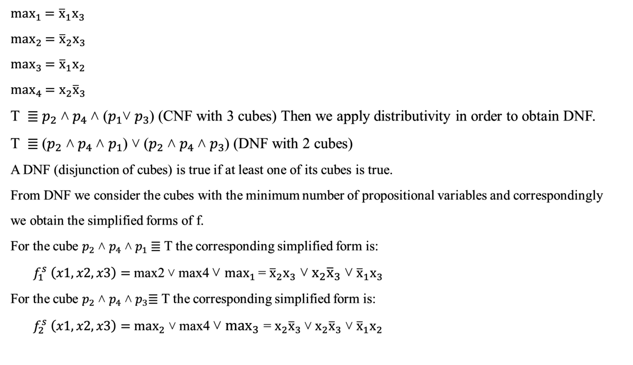
$max_{1}$ $={\overline{x}}_{1}x_{3}$
$max_{2}$ $={\overline{x}}_{2}x_{3}$
$max_{3}$ $={\overline{x}}_{1}x_{2}$
$max_{4}$ $=x_{2}{\overline{x}}_{3}$
T ≣ $p_{2}$ ˄ $p_{4}$˄ ($p_{1}$˅ $p_{3}$) (CNF with 3 cubes) Then we apply distributivity in order to obtain DNF.
T ≣ ${\text{(}p}_{2}$ ˄ $p_{4}$˄ $p_{1}$) ˅ ($p_{2}$ ˄ $p_{4}$˄ $p_{3}$) (DNF with 2 cubes)
A DNF (disjunction of cubes) is true if at least one of its cubes is true.
From DNF we consider the cubes with the minimum number of propositional variables and correspondingly
we obtain the simplified forms of f.
For the cube $p_{2}$ ˄ $p_{4}$˄ $p_{1}$≣ T the corresponding simplified form is:
$f_{1}^{s} \left(x1, x2, x3\right)=$ max2 ˅ max4 ˅ $max_{1}$= ${\overline{x}}_{2}x_{3}$ ˅ $x_{2}{\overline{x}}_{3}$ ˅ ${\overline{x}}_{1}x_{3}$
For the cube $p_{2}$ ˄ $p_{4}$˄ $p_{3}$≣ T the corresponding simplified form is:
$f_{2}^{s} \left(x1, x2, x3\right)=$ $max_{2}$ ˅ max4 ˅ $max_{3}$ = $x_{2}{\overline{x}}_{3}$ ˅ $x_{2}{\overline{x}}_{3}$ ˅ ${\overline{x}}_{1}x_{2}$

Slide 11

$$Conclusion$$
The simplified forms of function f3(x1,x2,x3)= m1 ˅ m2 ˅ m3 ˅ m5 ˅ m6 are:
$f_{1}^{s} \left(x1, x2, x3\right)=$ max2 ˅ max4 ˅ $max_{1}$= ${\overline{x}}_{2}x_{3}$ ˅ $x_{2}{\overline{x}}_{3}$ ˅ ${\overline{x}}_{1}x_{3}$
$f_{2}^{s} \left(x1, x2, x3\right)=$ $max_{2}$ ˅ max4 ˅ $max_{3}$ = $x_{2}{\overline{x}}_{3}$ ˅ $x_{2}{\overline{x}}_{3}$ ˅ ${\overline{x}}_{1}x_{2}$

